Slide 1
Compiler Construction
A Compulsory Module for Students in
Computer Science Department
Faculty of IT / Al – Al Bayt University
First Semester 2009/2010

Slide 2
Compiler Construction
Lecturer: Dr. Venus W. Samawi
Email: drvenus_uni@yahoo.com

Slide 3
Recommended Reading
The text book is:
Alfred V. Aho, Ravi Sethi and Jeffry D. Ulman, Compilers Principles, Techniques and Tools, Addison Wesley, 2007,
Supporting References:
  1- W. Appel, Modern Compiler Implementation in Java,
  Prentice Hall, 2002
  2- D. Watt, Brown, Programming Language Processors in
  Java: Compilers and Interpreters, Prentice hall, 2000

Slide 4
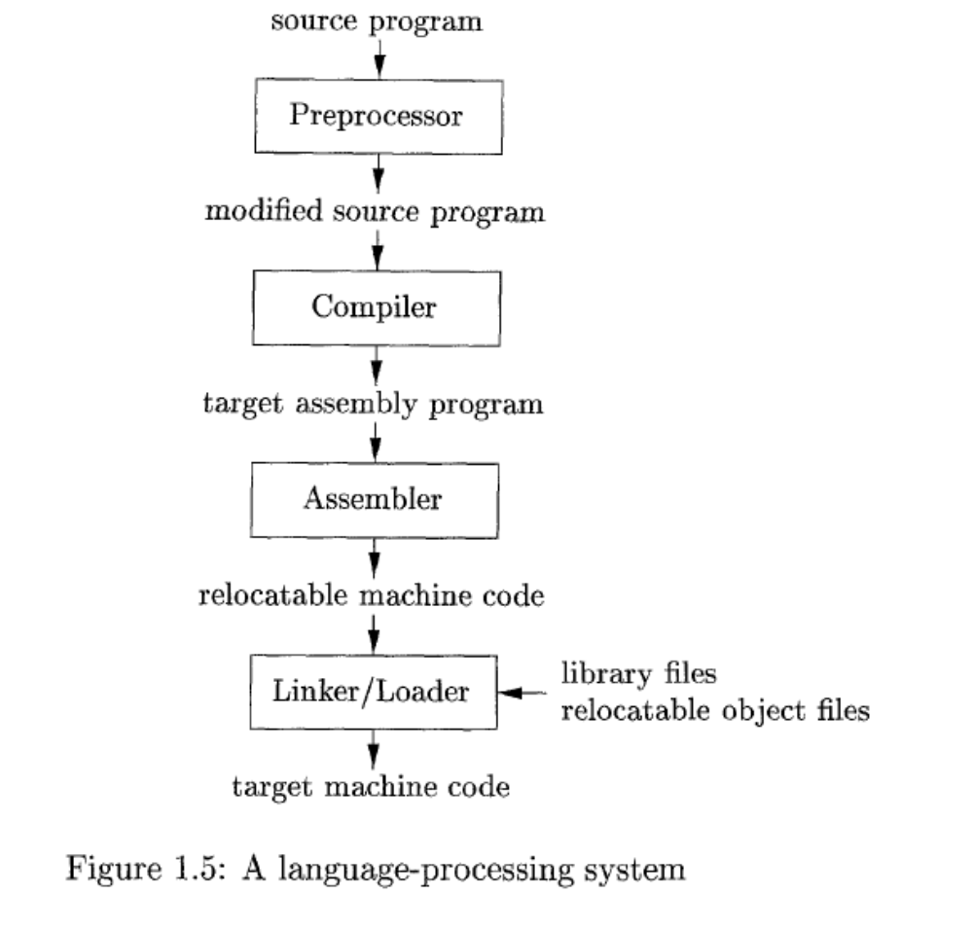
Language Processing System

Slide 5
Language Processors.
A translator inputs and then converts a source program into an object or target program.
Source program is written in a source language
Object program belongs to an object language
A translators could be: Assembler, Compiler, Interpreter
  Assembler:
  source program object program
  (in assembly language) (in machine language)
Assembler

Slide 6
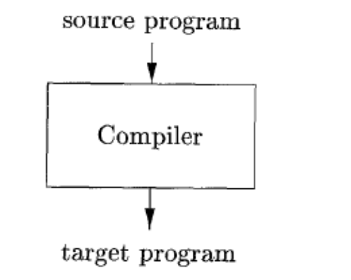
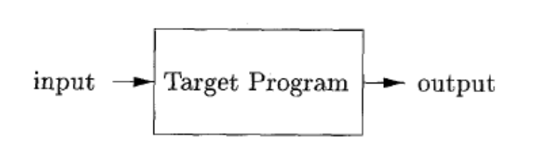
Language Processors.
a compiler is a program that can read a program in one language the source language - and translate it into an equivalent program in another language - the target language;
An important role of the compiler is to report any errors in the source program that it detects during the translation process
If the target program is an executable machine-language program, it can then be called by the user to process inputs and produce outputs;

Slide 7
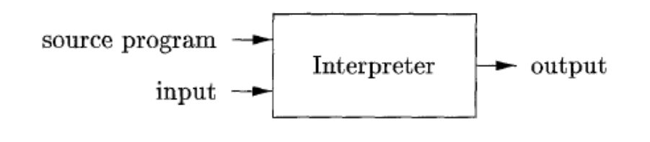
Interpreter
An interpreter is another common kind of language processor. Instead of producing a target program as a translation, an interpreter appears to directly execute the operations specified in the source program on inputs supplied by the user
The machine-language target program produced by a compiler is usually much faster than an interpreter at mapping inputs to outputs . An interpreter, however, can usually give better error diagnostics than a compiler, because it executes the source program statement by statement.

Slide 8
Overview of Compilers
  - Compiler: translates a source program written in a High-Level Language (HLL) such as Pascal, C++ into computer’s machine language (Low-Level Language (LLL)).
  * The time of conversion from source program into
  object program is called compile time
  * The object program is executed at run time
  - Interpreter: processes an internal form of the source program and data at the same time (at run time); no object program is generated.

Slide 9
Compilers and Interpreters
  Why Interpretation
  A higher degree of machine independence: high portability.
  Dynamic execution: modification or addition to user programs as execution proceeds.
  Dynamic data type: type of object may change at runtime
  Easier to write – no synthesis part.
  Better diagnostics: more source text information available

Slide 10
Overview of Compilers
  Compilation Process:
  Interpretive Process:
Data
Source
program
Object
program
Results
Compiler
Executing
Computer
Compile time
run time
Data
Source
program
Compiler
Result

Slide 11
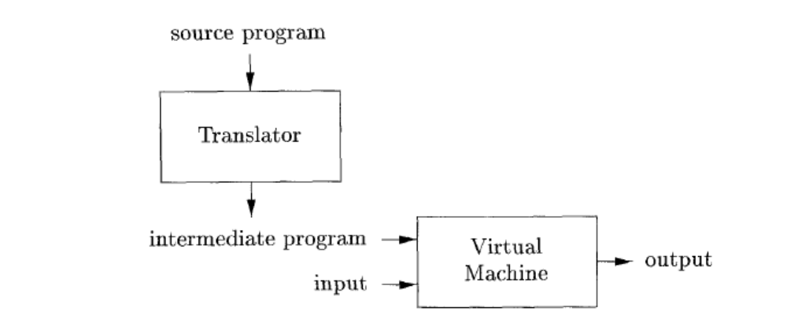
Example Of Combining Both Interpreter and Compiler
Java language processors combine
compilation and interpretation,
A Java source program may first be compiled into an intermediate form called bytecodes.
The bytecodes are then interpreted by a virtual machine. A benefit of this arrangement is that bytecodes compiled on one machine can be interpreted on another machine, perhaps across a network.
In order to achieve faster processing of inputs to outputs, some Java compilers, called just-in-time compilers, translate the bytecodes into machine language immediately before they run the intermediate program to process the input.

Slide 12
Model of A Compiler
A compiler must perform two tasks:
- analysis of source program: The analysis part breaks up the source program into constituent pieces and imposes a grammatical structure on them. It then uses this structure to create an intermediate representation of the source program.
- synthesis of its corresponding program: constructs the desired target program from the intermediate representation and the information in the symbol table.
The analysis part is often called the front end of the compiler; the synthesis part is the back end.

Slide 13
source program object program
Analysis
Lexical Syntactic Semantic
Analysis Analysis Analysis
Synthesis
Code Code
Generator optimizer
Tables

Slide 14
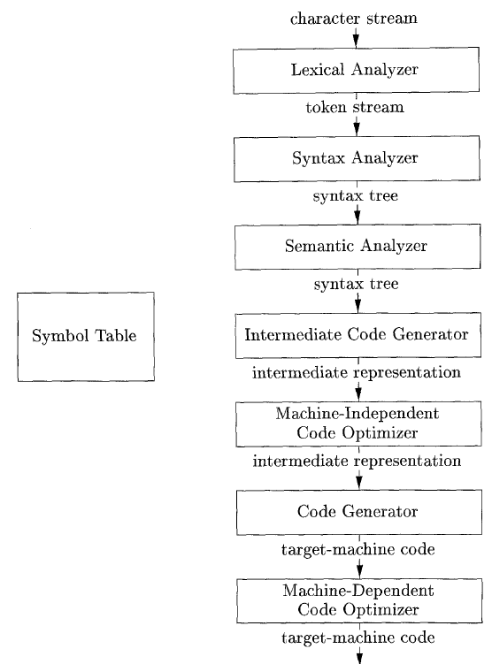
Tasks of Compilation Process and Its Output
Error handler
Compiler phases

Slide 15
Lexical Analysis (scanner): The first phase of a compiler
Lexical analyzer reads the stream of characters making up the source program and groups the characters into meaningful sequences called lexeme
For each lexeme, the lexical analyzer produces a token of the form that it passes on to the subsequent phase, syntax analysis
(token-name, attribute-value)
Token-name: an abstract symbol is used during syntax analysis, an
attribute-value: points to an entry in the symbol table for this token.

Slide 16
Example: position =initial + rate * 60
1.”position” is a lexeme mapped into a token (id, 1), where id is an abstract symbol standing for identifier and 1 points to the symbol table entry for position. The symbol-table entry for an identifier holds information about the identifier, such as its name and type.
2. = is a lexeme that is mapped into the token (=). Since this token needs no attribute-value, we have omitted the second component. For notational convenience, the lexeme itself is used as the name of the abstract symbol.
3. “initial” is a lexeme that is mapped into the token (id, 2), where 2 points to the symbol-table entry for initial.
4. + is a lexeme that is mapped into the token (+).
5. “rate” is a lexeme mapped into the token (id, 3), where 3 points to the symbol-table entry for rate.
6. * is a lexeme that is mapped into the token (*) .
7. 60 is a lexeme that is mapped into the token (60)
Blanks separating the lexemes would be discarded by the lexical analyzer.

Slide 17

Syntax Analysis (parser) : The second phase of the compiler
The parser uses the first components of the tokens produced by the lexical analyzer to create a tree-like intermediate representation that depicts the grammatical structure of the token stream.
A typical representation is a syntax tree in which each interior node represents an operation and the children of the node represent the arguments of the operation

Slide 18
Syntax Analysis Example
Pay := Base + Rate* 60
The seven tokens are grouped into a parse tree
Assignment stmt
identifier
expression
:=
pay
expression
expression
+
identifier
Rate*60
base

Slide 19
Semantic Analysis: Third phase of the compiler
The semantic analyzer uses the syntax tree and the information in the symbol table to check the source program for semantic consistency with the language definition.
Gathers type information and saves it in either the syntax tree or the symbol table, for subsequent use during intermediate-code generation.
An important part of semantic analysis is type checking, where the compiler checks that each operator has matching operands. For example, many programming language definitions require an array index to be an integer; the compiler must report an error if a floating-point number is used to index an array.
The language specification may permit some type conversions called coercions. For example, a binary arithmetic operator may be applied to either a pair of integers or to a pair of floating-point numbers. If the operator is applied to a floating-point number and an integer, the compiler may convert or coerce the integer into a floating-point number.

Slide 20
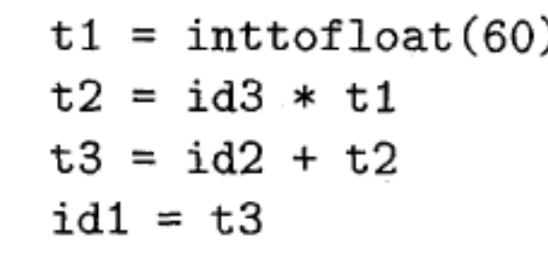
Intermediate Code Generation: three-address code
After syntax and semantic analysis of the source program, many compilers generate an explicit low-level or machine-like intermediate representation (a program for an abstract machine). This intermediate representation should have two important properties:
  it should be easy to produce and
  it should be easy to translate into the target machine.
The considered intermediate form called three-address code, which consists of a sequence of assembly-like instructions with three operands per instruction. Each operand can act like a register.

Slide 21
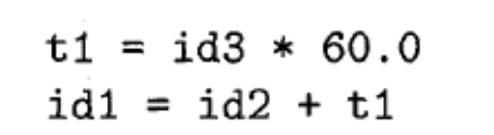
Code Optimization: to generate better target code
The machine-independent code-optimization phase attempts to improve the intermediate code so that better target code will result.
Usually better means:
  faster, shorter code, or target code that consumes less power.
The optimizer can deduce that the conversion of 60 from integer to floating point can be done once and for all at compile time, so the int to float operation can be eliminated by replacing the integer 60 by the floating-point number 60.0. Moreover, t3 is used only once
There are simple optimizations that significantly improve the running time of the target program without slowing down compilation too much.

Slide 22
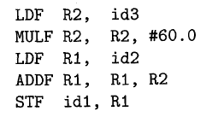
Code Generation: takes as input an intermediate representation of the source program and maps it into the target language
If the target language is machine, code, registers or memory locations are selected for each of the variables used by the program.
Then, the intermediate instructions are translated into sequences of machine instructions that perform the same task.
A crucial aspect of code generation is the judicious assignment of registers to hold variables.

Slide 23
Symbol-Table Management:
The symbol table is a data structure containing a record for each variable name, with fields for the attributes of the name.
The data structure should be designed to allow the compiler to find the record for each name quickly and to store or retrieve data from that record quickly
These attributes may provide information about the storage allocated for a name, its type, its scope (where in the program its value may be used), and in the case of procedure names, such things as the number and types of its arguments, the method of passing each argument (for example, by value or by reference), and the type returned.

Slide 24
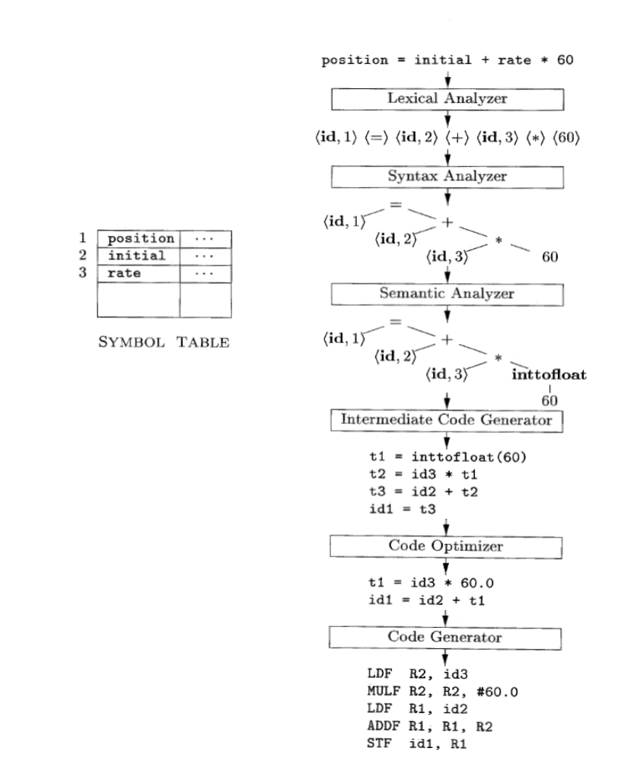
Translation of an assignment statement

Slide 25
Grouping of Compiler Phases
Front end
  Consist of those phases that depend on the source language but largely independent of the target machine.
Back end
  Consist of those phases that are usually target machine dependent such as optimization and code generation.

Slide 26
Common Back-end Compiling System
Fortran
C/C++
Pascal
Cobol
Common IR (e.g. Ucode)
Optimizer
Target Machine Code Gen

Slide 27
Compiling Passes
Several phases can be implemented as a single pass consist of reading an input file and writing an output file.
A typical multi-pass compiler looks like:
  First pass: preprocessing, macro expansion
  Second pass: syntax-directed translation, IR code generation
  Third pass: optimization
  Last pass: target machine code generation

Slide 28
Cousins of Compilers
Preprocessors
Assemblers
  Compiler may produce assembly code instead of generating relocatable machine code directly.
Loaders and Linkers
  Loader copies code and data into memory, allocates storage, setting protection bits, mapping virtual addresses, .. Etc
  Linker handles relocation and resolves symbol references.
Debugger

Slide 29
Tasks of Compilation Process and Its Output
Each tasks is assigned to a phase, e.g. Lexical Analyzer phase, Syntax Analyzer phase, and so on.
Each task has input and output.
Any thing between brackets in the last figure is output of a phase.
The compiler first analyzes the program, the result is representations suitable to be translated later on:
- Parse tree
- Symbol table

Slide 30
Parse Tree and Symbol Table
Parse tree defines the program structure; how to combine parts of the program to produce larger part and so on.
Symbol table provides
- the associations between all occurrences of each
name given in the program.
- It provides a link between each name and it
declaration.

